Slide 1

LENDING CLUB LOAN ANALYSIS
Presented by: Priya Sharma and Sri Priya Valluru

Slide 2

Agenda
Identifying the Business Problem
Business Objectives
Approach
Results
Recommendation & Conclusion

Slide 3
Business Problem
Identify the risky loan applicants, so that such loans approvals can be reduced which will cut down the amount of credit loss. Identification of such applicants by using EDA to understand how consumer attributes and loan attributes influence the tendency of default.
Business Objectives
Objective is to identify the risky loan applicants at the time of loan application so that such loans can be reduced thereby cutting down the amount of credit loss.
understand the driving factors (or driver variables) behind loan default, the variables which are strong indicators of default. The company can utilize this analysis for risk assessment. And thus minimize the risk of losing money while lending to customers.

Slide 4
Approach
Data Review and Cleansing
Missing value identification
Outlier observations
Elimination of unrequired data elements & consolidation of dataset
Univariate Analysis : Categorical and numerical
Correlation analysis and observations
Bivariate Analysis and observation
Conclusion & Recommendations

Slide 5
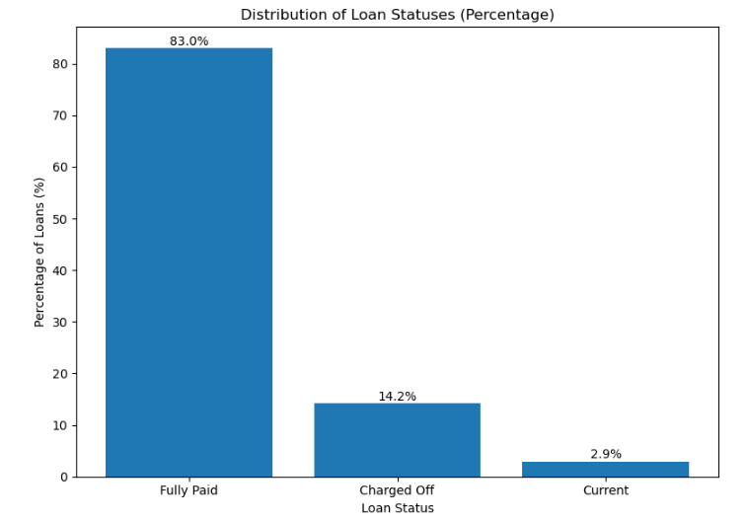
Loan Status
Fully Paid | 32949
Charged Off | 5626
Current | 1140

Slide 6
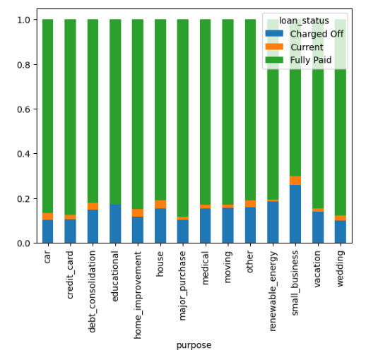
Purpose
The charged off is higher under loan purpose “small business”.
purpose
debt_consolidation 18641
credit_card 5130
other 3992
home_improvement 2976
major_purchase 2187
small_business 1827
car 1549
wedding 947
medical 693
moving 583
vacation 381
house 381
educational 325
renewable energy 103
Loan Purpose | Percentage Charged Off (%)
car | 10.33
credit_card | 10.57
debt_consolidation | 14.84
educational | 17.23
home_improvement | 11.66
house | 15.49
major_purchase | 10.15
medical | 15.30
moving | 15.78
other | 15.86
renewable_energy | 18.45
small_business | 25.94
vacation | 13.91
wedding | 10.14

Slide 7
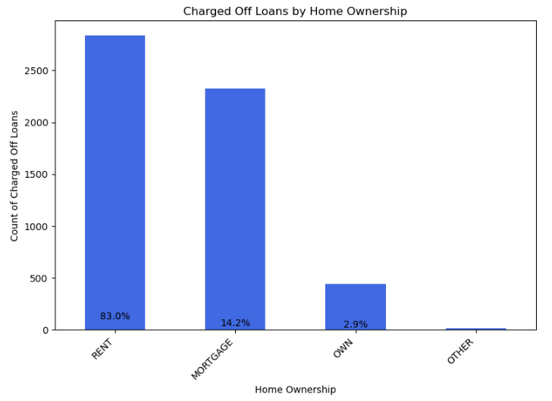
Home Ownership
Based on the graph, most of them are living in rented home or mortgage their home. Charged off Loans is higher under Rent.
home_ownership
RENT 18898
MORTGAGE 17658
OWN 3058
OTHER 98
NONE 3

Slide 8
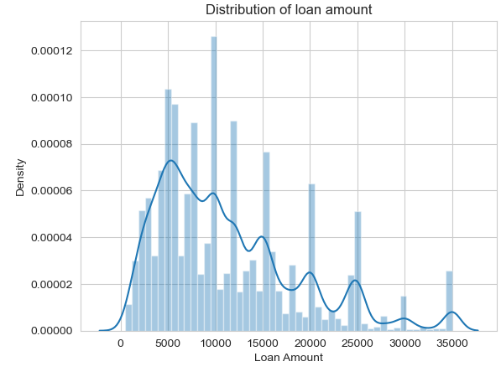
Loan Amount
We can see from the graph that the distribution of loan amount considered is high in b/w 5000 to 15000. This implies, borrowers applying for loan around this range.

Slide 9
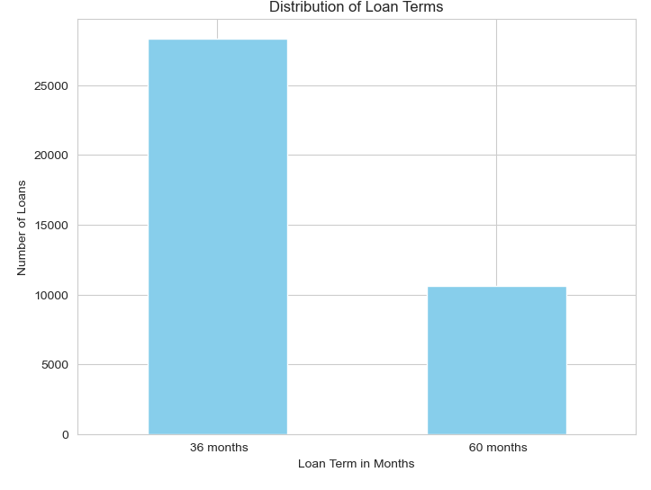
Loan Terms 36 & 60 mths
We can see that 36 months term have more distribution

Slide 10
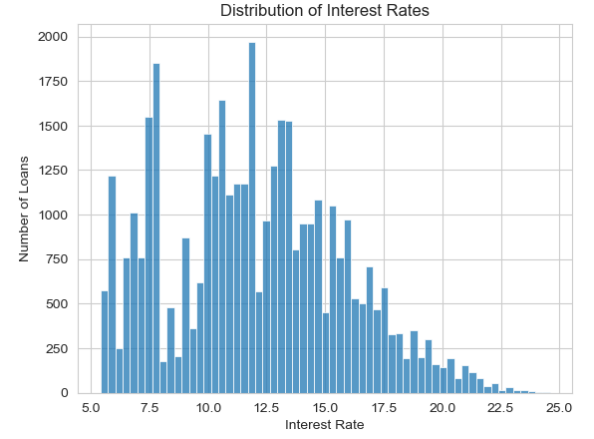
Loan Interest Rate
We can see that from the graph, the number of loans given at the interest rate of 10-15%.

Slide 11
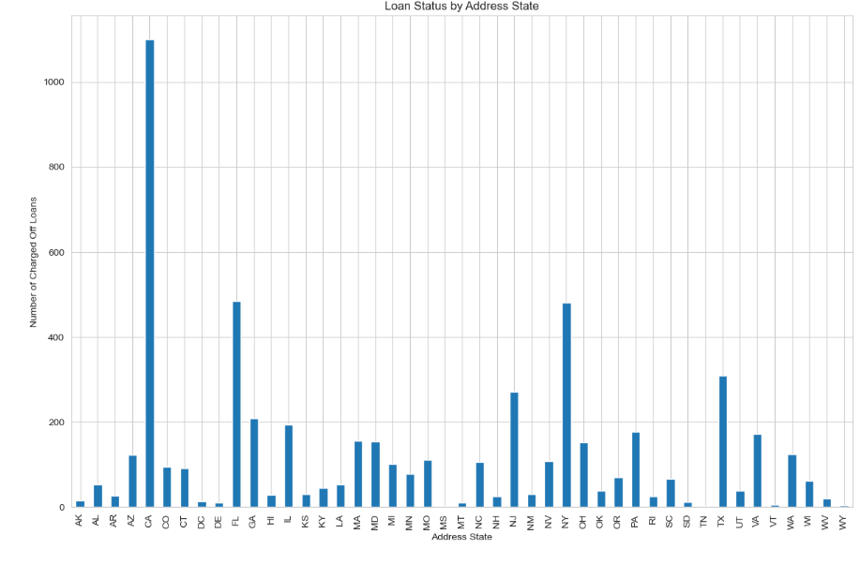
Address States
We can see that, in the CA,FL,TX & NY state, have higher charged off loans

Slide 12
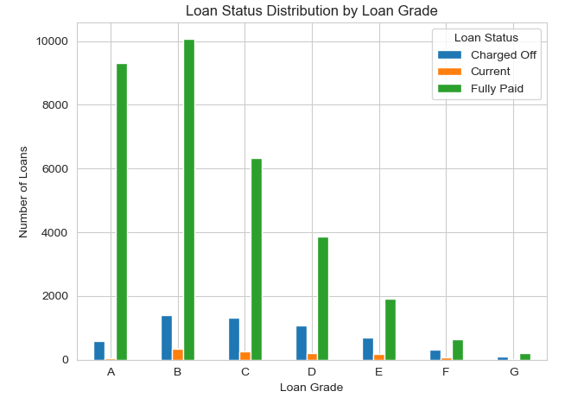
Loan Grade
The Charged Off is high in the Grade B as we can see from the graph

Slide 13
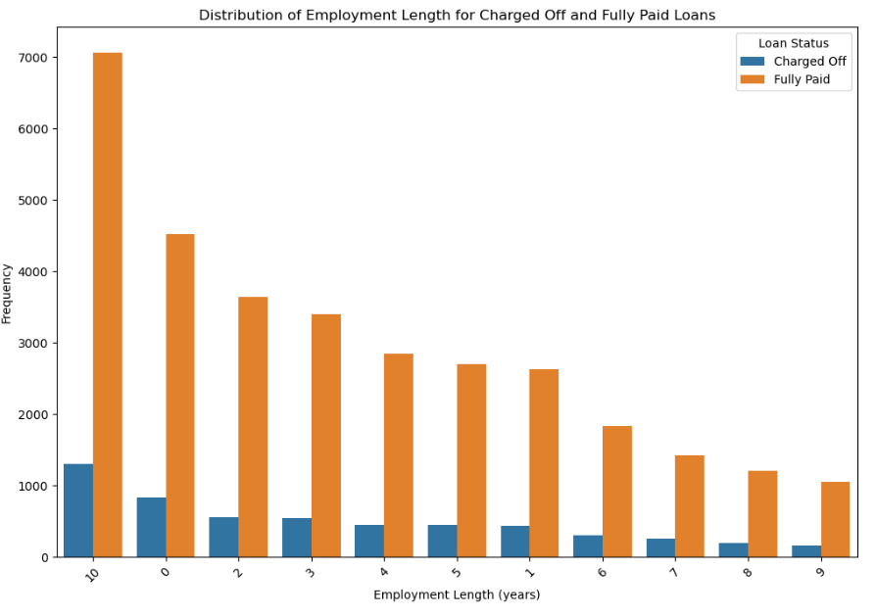
Employment Length
Mostly 10+ years of experience employer have chances to be a defaulters and then next we have < 1 year experience borrowers.

Slide 14
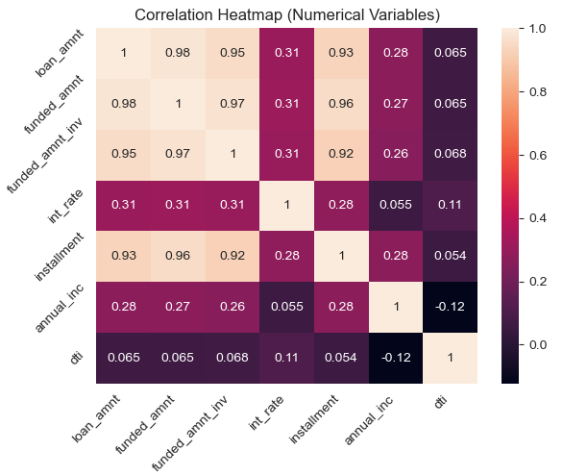
Heatmap
Loan amount, investor amount, funding amount are strongly correlated.
Annual_inc and dti (-0.12): This is a weak correlation, and it suggests that as annual income increases, the DTI tends to decrease slightly, but the relationship is not strong.

Slide 15
Conclusion & Recommendations
Grades is considered the one of the factor affecting in increase defaulters. The company should focus on reviewing the information provided by the borrowers in more detailed manner before issuing the loan
Company should reduce giving loans to small business and debt consolidation since the defaulters are high under these purpose
Borrowers with Rent home ownership are defaulting. Company should consider other factors while approving the loan. Factors such as annual income, experience etc…
Company should re-evaluate before issuing the loans to CA,FL,TX & NY status to increase the profit
Employee experience with 10 + yrs and less then 1 yrs have chance of defaulters. Company should look to exclude these applications.

